Slide 1


A Seminar on “Web Technology” Topic – Car Rental Website Presented By B-62 Yogesh Tukaram Sutar Class : S.Y.-B Sem-2 Under the guidance of Prof. Sonal Patil
Department of Computer Science and Engineering
N.K. Orchid College of Engineering & Technology, Solapur.
2022-2023

Slide 2

Contents
Introduction
About the website
HTML
CSS
JavaScript
PHP
Scope
Advantages
Conclusion

Slide 3
Introduction
In today's fast-paced world, convenience and flexibility are paramount, and that's exactly what our website aims to provide. Whether you're a traveller in need of a vehicle for your vacation, a business professional requiring transportation for a meeting, or simply someone who prefers the convenience of renting a car, our website is designed to cater to all your needs.
our car rental website offers a convenient, reliable, and hassle-free solution for all your transportation needs.

Slide 4
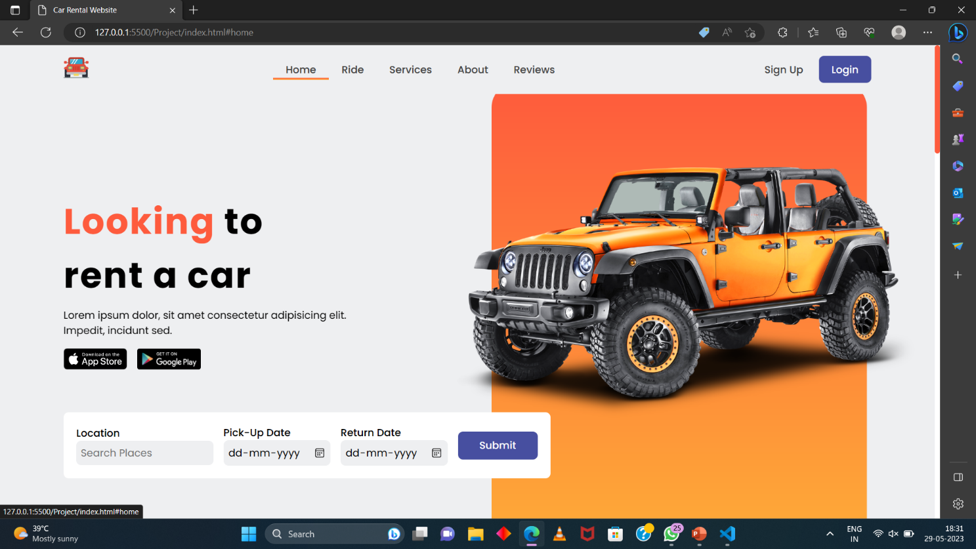
About the Website

Slide 5
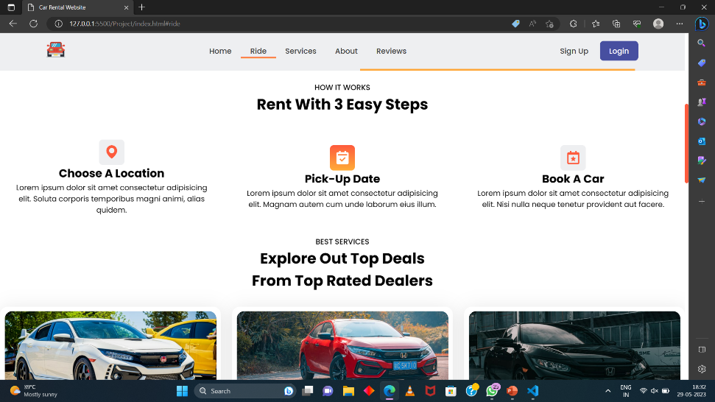
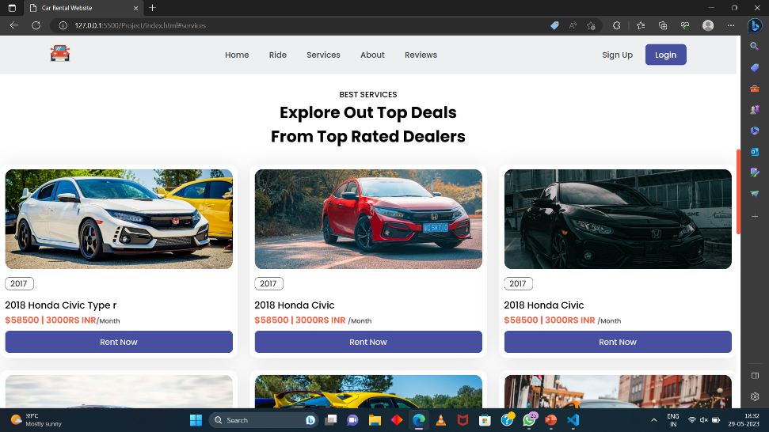
About the Website

Slide 6
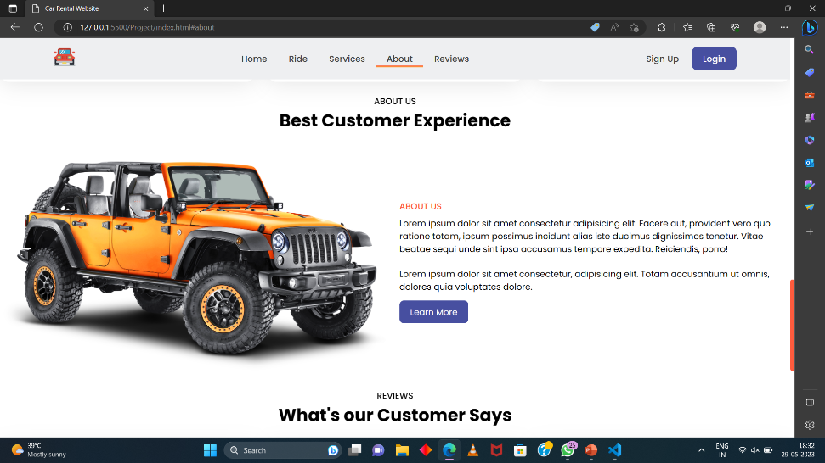
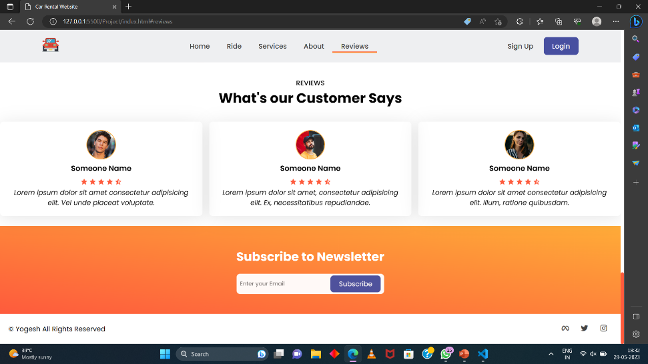
About the Website

Slide 7
HTML
HTML stands for Hyper Text Markup Language
HTML is the standard markup language for creating Web pages
HTML describes the structure of a Web page
HTML consists of a series of elements
HTML elements tell the browser how to display the content
HTML elements label pieces of content such as "this is a heading", "this is a paragraph", "this is a link", etc.

Slide 8
HTML ATTRIBUTES
All HTML elements can have attributes
Attributes provide additional information about elements
Attributes are always specified in the start tag
Attributes usually come in name/value pairs like: name="value“
The href attribute of <a> specifies the URL of the page the link goes to
The src attribute of <img> specifies the path to the image to be displayed
The width and height attributes of <img> provide size information for images
The alt attribute of <img> provides an alternate text for an image
The lang attribute of the <html> tag declares the language of the Web page

Slide 9
css
CSS stands for Cascading Style Sheets
CSS describes how HTML elements are to be displayed on screen, paper, or in other media
CSS saves a lot of work. It can control the layout of multiple web pages all at once
External stylesheets are stored in CSS files

Slide 10
CSS Padding
The CSS padding properties are used to generate space around an element's content, inside of any defined borders.
CSS has properties for specifying the padding for each side of an element:
padding-top
padding-right
padding-bottom
padding-left
All the padding properties can have the following values:
length - specifies a padding in px, pt, cm, etc.
% - specifies a padding in % of the width of the containing element
inherit - specifies that the padding should be inherited from the parent element

Slide 11
JavaScript
JavaScript is a high-level, interpreted programming language primarily used for creating dynamic and interactive web content. It allows developers to add behavior, interactivity, and functionality to web pages. JavaScript is supported by all modern web browsers and is an essential component of front-end web development.
Key Features of JavaScript:
Event-driven programming: JavaScript responds to user actions and system events.
DOM manipulation: JavaScript interacts with the Document Object Model to modify web page elements.
Functionality and interactivity: JavaScript provides built-in functions for tasks like form validation and data manipulation.
Integration with HTML and CSS:
JavaScript seamlessly integrates with HTML and CSS, allowing dynamic updates to web pages and styles.
It enhances user interaction and user experience on the web.
Popular JavaScript Libraries and Frameworks:
jQuery: Simplifies JavaScript code and provides a wide range of utilities.
React: A JavaScript library for building user interfaces, commonly used for single-page applications.
Angular: A full-featured framework for building complex web applications.
Vue.js: A progressive JavaScript framework for building user interfaces.
Client-Side and Server-Side JavaScript:
Initially used for client-side scripting, JavaScript can now be used for server-side development with Node.js.
Node.js enables scalable and efficient server applications using JavaScript.

Slide 12
PHP
PHP is an acronym for "PHP: Hypertext Preprocessor"
PHP is a widely-used, open source scripting language
PHP scripts are executed on the server
PHP is free to download and use
PHP files can contain text, HTML, CSS, JavaScript, and PHP code
PHP code is executed on the server, and the result is returned to the browser as plain HTML
PHP files have extension ".php"
It is powerful enough to be at the core of the biggest blogging system on the web (WordPress)
It is deep enough to run large social networks!

Slide 13
Scope
The scope of a car rental website includes features such as a comprehensive vehicle inventory, online booking system, reservation management, user accounts, transparent pricing, location availability, customer support, mobile compatibility, additional services, and analytics/reporting
A car rental Website simplifies renting a car, enabling users to search for available vehicles, select pick-up locations and times, choose a car type, and manage their booking. The website helps rental companies to manage their fleet, track reservations, and handle customer requests. Features like real-time car availability, GPS tracking, and nearby locations increase convenience for customers. The website benefits customers and rental companies, providing a more efficient and convenient rental experience..

Slide 14
Advantages
Convenience: A car rental website provides customers with the convenience of browsing and booking vehicles online at any time, from anywhere. It eliminates the need to physically visit rental offices, saving time and effort.Provide personal access
Time and Cost Savings: Renting a car through a website can save customers both time and money. They can easily compare prices, find the best deals or discounts, and make cost-effective choices.
Access to Additional Services: Car rental websites may offer additional services like airport transfers, optional equipment rentals (e.g., GPS, child seats), or special packages. Customers can conveniently add these services to their booking, enhancing their overall rental experience.

Slide 15
Conclusion
In conclusion, the Car Rental Website project aims to revolutionize the way people rent vehicles by offering a convenient, user-friendly, and comprehensive online platform. Through this project, we have successfully developed a website that provides a wide selection of vehicles, transparent pricing, and an effortless booking process. The project's advantages include the convenience it brings to customers, cost and time savings, flexibility in rental options, and access to additional services. With its user accounts, customer support, and data analytics capabilities, the website ensures a seamless and personalized rental experience. We believe that this Car Rental Website project will greatly enhance customer satisfaction, optimize operational efficiency, and establish a strong foothold in the competitive car rental market.

Slide 16
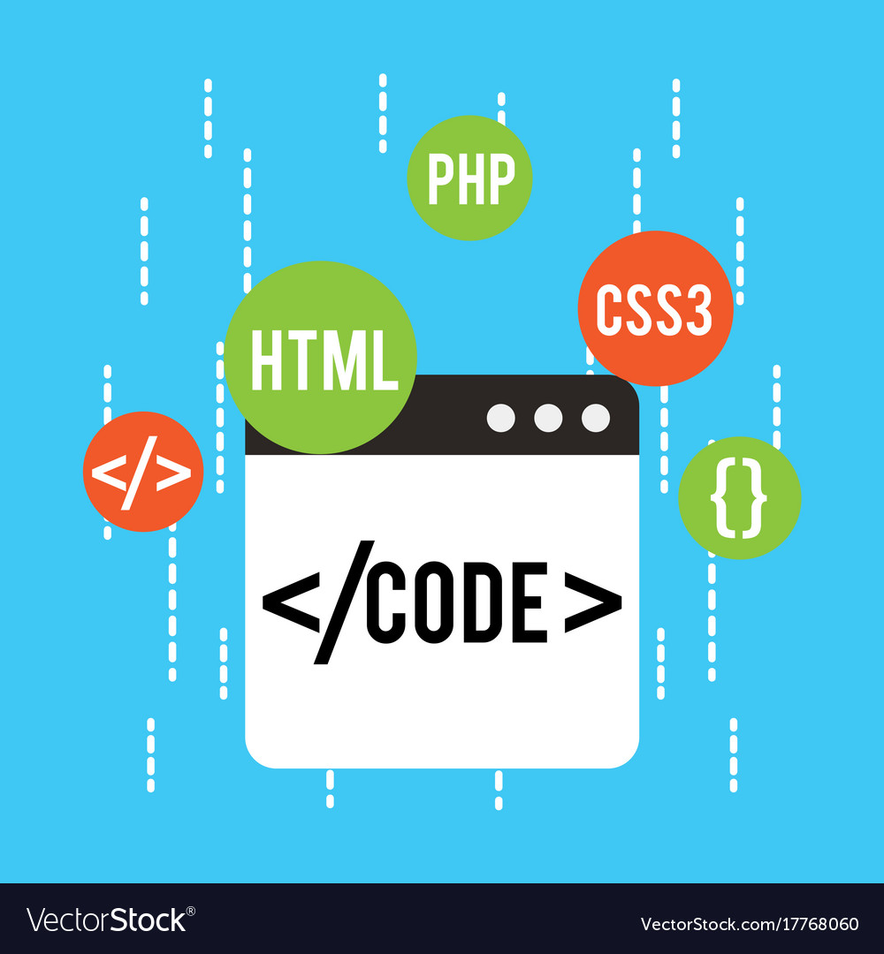
THANK YOU

